Slide 1
SOLVING SUDOKU WITH MATLAB
Raluca Marinescu, Andrea Garcia, Ivan Castro, Eduard Enoiu
Mälardalen University, Västerås, 28.02.2011

Slide 2
Background Of Sudoku
From the Japanese: ”SU”, means ”number” and ”DOKU”, means ”single”.
It is based on the concept of Latin Squares (similar to magic squares) introduced by Leonhard Euler in the 18th century.
The board is composed by a 9x9 grid. The whole grid is divided into sub-squares containing a 3x3 grid each.
The purpose of the game is to insert numbers (1-9) in the board without repeating a number in each row, column or sub-square.

Slide 3
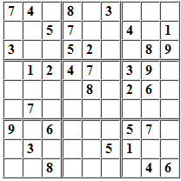
Problem Description
Design and Implement a Sudoku Puzzle Solver using Matlab.

Slide 4
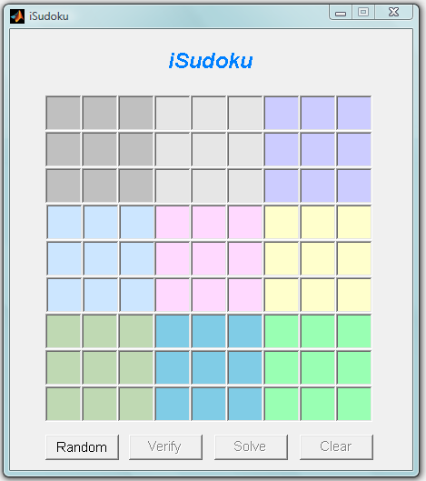
Graphical User Interface
Implemented using Matlab’s GUI Design Environment (GUIDE).
Used drag & drop components to create the layout.
Each component has:
A list of properties that can be edited (color, size, position, etc)
Callback functions to model its behavior.
Static Text
Textbox
Button

Slide 5
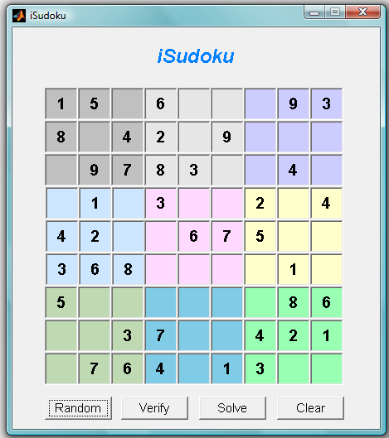
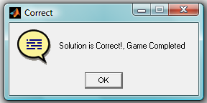
Graphical User Interface
Functionality is achieved using four buttons:
Random
Creates and displays a random game
Solve
Solves the game and displays the solution
Verify
Verifies the correctness of the game
Clear
Clears the board

Slide 6
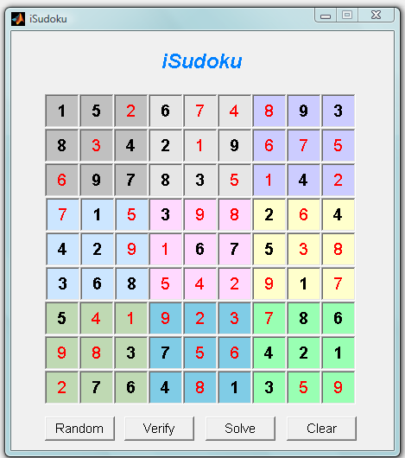
Graphical User Interface
Clear
Random
Solve
4
2
3
1
Verify
Simplified program operation:
Games are loaded from an Excel database.
Random game is displayed.
Game matrix is sent to the sudoku algorithm.
Solved matrix is received and displayed.

Slide 7
Graphical User Interface
Example of a callback function (Clear button):
Function that is called after the event (mouse click)
% --- Executes on button press in ClearBtn.
function ClearBtn_Callback(hObject, eventdata, handles)
% handles structure with handles and user data (see GUIDATA)
%Clear the board
for rowInd = 1:9
for colInd = 1:9
cName = ['c' num2str(rowInd) num2str(colInd)];
cValue = '';
expr = ['set(handles.' cName ', ''String'', ''' cValue ''',...
''FontWeight'', ''normal'', ''Enable'', ''on'')'];
eval(expr);
end
end
set(handles.SolveBtn, 'Enable', 'off');
set(handles.verifyBtn, 'Enable', 'off');
Puts an empty string on every textbox component in the board
Disables the buttons

Slide 8
SOLVING SUDOKU WITH MATLAB
ALGORITHM
The key internal function is:
iSudokuALG(A)

Slide 9
SOLVING SUDOKU WITH MATLAB
ALGORITHM
The key internal function is:
iSudokuALG(A)
Steps:
(1) Find all the possible values for the empty cell

Slide 10
SOLVING SUDOKU WITH MATLAB
ALGORITHM
The key internal function is:
iSudokuALG(A)
Steps:
(1) Find all the possible values for the empty cell
for i=1:9
for j=1:9
if (A(i,j)+B(i,j))==0
possible=[];
for k=1:9
B(i,j)=k;
flag2=verific(A+B);
if flag2==0
possible=[possible k];
end
end
B(i,j)=0;
if length(possible)==1
B(i,j)=possible;
end
end
end
end
Empty cell found
Look for all possible values

Slide 11
SOLVING SUDOKU WITH MATLAB
ALGORITHM
The key internal function is:
iSudokuALG(A)
Steps:
(2) if the cell has only one possible value, fill it
for i=1:9
for j=1:9
if (A(i,j)+B(i,j))==0
possible=[];
for k=1:9
B(i,j)=k;
flag2=verific(A+B);
if flag2==0
possible=[possible k];
end
end
B(i,j)=0;
if length(possible)==1
B(i,j)=possible;
end
end
end
end
Fill the possible value

Slide 12
SOLVING SUDOKU WITH MATLAB
ALGORITHM
The key internal function is:
iSudokuALG(A)
Steps:
(1) Find all the possible values for the empty cell
(2) if the cell has only one possible value, fill it
(3) If all the cells have more than one possible value we fill in a tentative value for one cell
(4) Verify the puzzle:
function [val]=verific(A)

Slide 13
SOLVING SUDOKU WITH MATLAB
ALGORITHM EXAMPLE
We assume for simplification in this example a simpler 4 by 4 grid with 2 by 2 blocks

Slide 14
SOLVING SUDOKU WITH MATLAB
ALGORITHM EXAMPLE
 |  |  | 1
 |  | 2
 | 3
4

Slide 15
SOLVING SUDOKU WITH MATLAB
ALGORITHM EXAMPLE
23 | 24 | 34 | 1
13 | 14 | 2 | 34
12 | 3 | 14 | 24
4 | 12 | 13 | 23

Slide 16
SOLVING SUDOKU WITH MATLAB
ALGORITHM EXAMPLE
2 | 4 | 34 | 1
13 | 14 | 2 | 34
1 | 3 | 14 | 24
4 | 12 | 13 | 23

Slide 17
SOLVING SUDOKU WITH MATLAB
ALGORITHM EXAMPLE
2 | 4 | 3 | 1
3 | 1 | 2 | 34
1 | 3 | 4 | 24
4 | 2 | 13 | 23

Slide 18
SOLVING SUDOKU WITH MATLAB
ALGORITHM EXAMPLE
2 | 4 | 3 | 1
3 | 1 | 2 | 4
1 | 3 | 4 | 2
4 | 2 | 1 | 3

Slide 19
SOLVING SUDOKU WITH MATLAB
ALGORITHM EXAMPLE
2 | 4 | 3 | 1
3 | 1 | 2 | 4
1 | 3 | 4 | 2
4 | 2 | 1 | 3

Slide 20
Conclusions
There is a large number of possible algorithms to solve Sudoku puzzles, from the brute force algorithm to stochastic search algorithms.
Finding a suitable algorithm to solve any particular Sudoku game proved to be very difficult.
Using a GUI helped the developers to generate Sudoku games and verify solutions in a simple and quick way.
The obtained results using the implemented Sudoku solver have been successful, for this reason we don’t foresee any major changes to our solution.

Slide 21
Demo

